Slide 1
Convolutional Neural Network
Slides from http://wangshusen.github.io/teaching/CS583A20Spring/index.html

Slide 2
Warmup: Inner Products
Notes:
内积

Slide 3
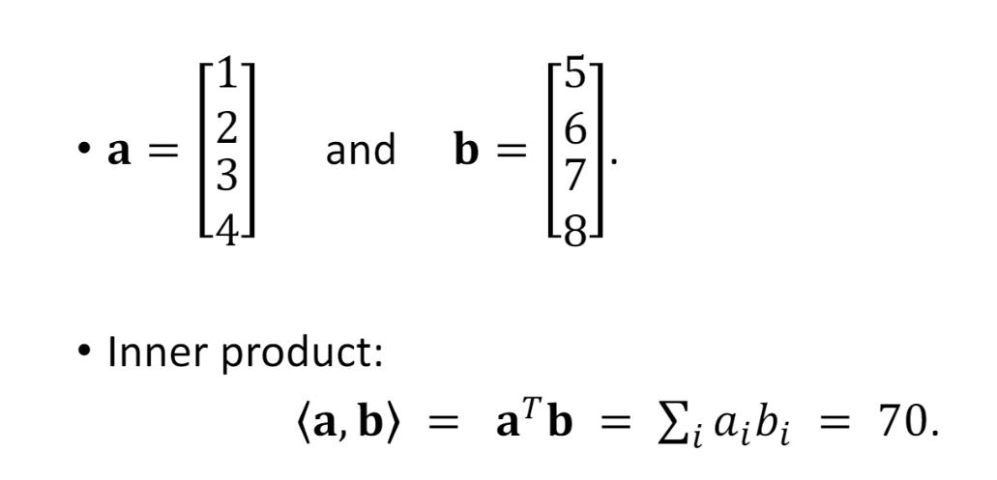
Vector Inner Product
Notes:
向量内积

Slide 4
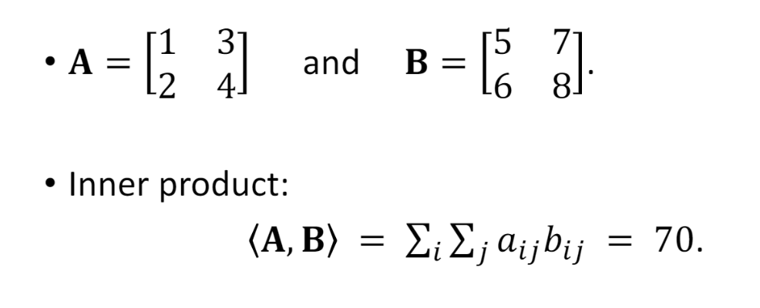
Matrix Inner Product
Notes:
矩阵内积

Slide 5
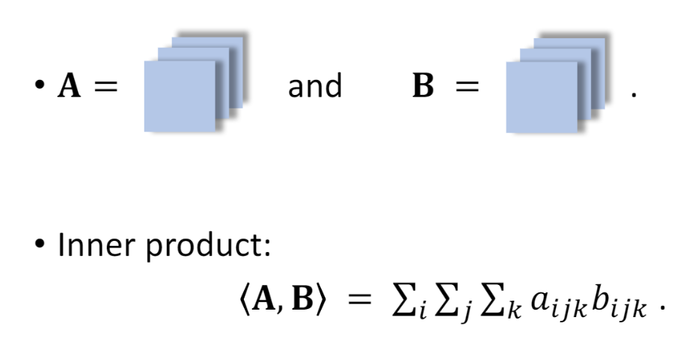
Tensor Inner Product
Notes:
张量内积

Slide 6
Why Convolutional Neural Network (CNN) for Image

Slide 7
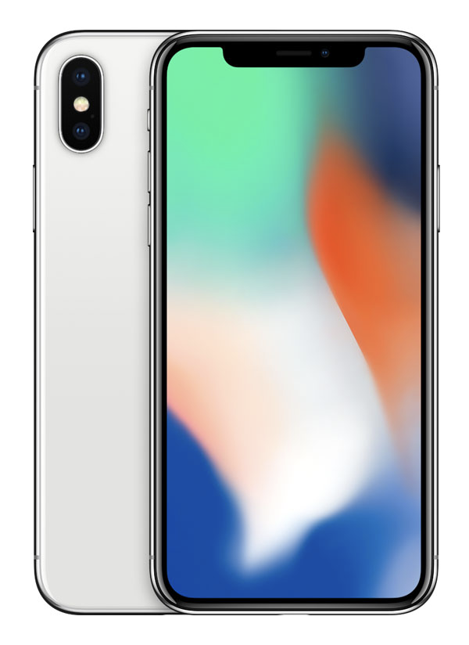
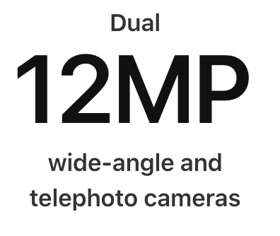
Classifying Dogs and Cats in Images
Use a good camera
RGB image has 36M elements
The model size of a single hidden layer MLP with a 100 hidden size is 3.6 Billion parameters
Exceeds the population of dogs and cats on earth (900M dogs + 600M cats)
Notes:
对包含猫的图片和包含狗的图片进行分类
使用一个好的相机，得到的RGB图片有36M像素
如果用MLP模型(多层感知器)进行识别，只包含一个具有100个隐藏结点单隐藏层的MLP模型含有的参数大小是36亿。
超过地球上的猫狗数量（9亿只狗+6亿只猫）

Slide 8
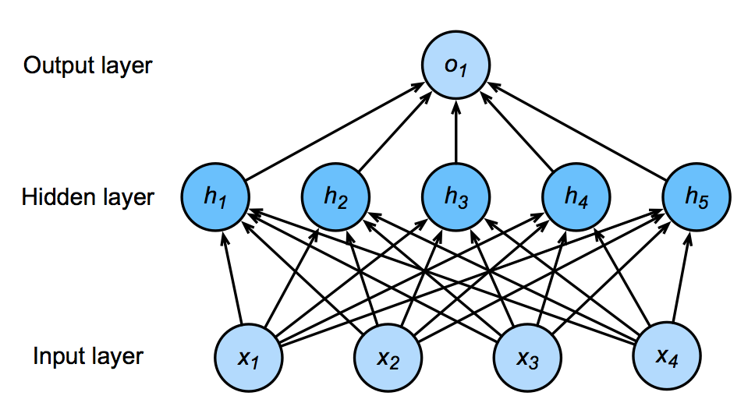
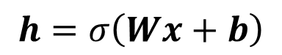
Network with One Hidden Layer
100 neurons
3.6B parameters = 14GB
36M features
$$h=σ\left(Wx+b\right)$$
Notes:
36M * 100

Slide 9


Why CNN for Image
Some patterns are much smaller than the whole image
A neuron does not have to see the whole image to discover the pattern.
Connecting to small region with less parameters
“beak” detector
Notes:
cnn的局部区域连接、权重共享和下采样三大结构特性使得它在图像识别领域表现出色。
在图像识别过程中，一些需要识别出来的图案比整个图片要小很多。对于这种图案，神经元不需要输入整个图片的信息，只输入局部信息就可以识别出来。
比如我们要识别的鸟嘴巴只占了整个图片的很小一部分，那么我们不需要输入整个图片的信息，只需将鸟嘴巴这一小部分图案输入到感知机算法中就可以得到一个“鸟嘴”识别器。
在cnn的结构中，cnn的局部区域连接特点与图像识别中的这一性质相符合。cnn中每一个卷积核都有一个局部感受野来获取图像的区域特征，因此可以用更少的参数将局部特征识别器与较小的区域连接起来。

Slide 10

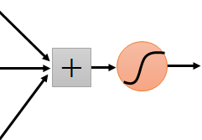
Why CNN for Image
The same patterns appear in different regions.
“upper-left beak” detector
Do almost the same thing
They can use the same set of parameters.
“middle beak” detector
Notes:
同时，在图像识别过程中，相同的图案可能会出现在不同图片的不同区域，比如第一幅图的鸟嘴巴出现在图片的左上角，第二幅图的鸟嘴巴出现在图片的中间部分。
尽管他们出现的位置不同，但是这些鸟嘴识别器基本上都是在做同样的事情，即将鸟嘴部分的图案输入到感知机中进行识别，那么，这些鸟嘴识别器可以使用相同的参数，也就是参数共享。
在cnn的结构中，cnn的权重共享的特点与图像识别中的这一性质相符合，即cnn在卷积的过程中，整个图片中共享同一个卷积核内的参数，不管鸟嘴的位置在哪里，都可以准确识别且减少了需要学习的参数。

Slide 11


Why CNN for Image
Subsampling the pixels will not change the object
bird
bird
subsampling
We can subsample the pixels to make image smaller
Less parameters for the network to process the image
Notes:
在图像识别中，图像下采样不会改变对象。对图像进行下采样可以使图片更小，能够在图像识别过程中使用更少的参数
在cnn的结构中，cnn的池化操作与图像识别中的这一性质相符合，通过最大池化操作可以对图像进行重采样，减少参数的学习，避免过拟合，同时还使得池化输出的特征具有平移不变性
所以说，cnn的三大结构特性使得它在图像处理领域表现出色。

Slide 12


The whole CNN
cat dog ……
Convolution
Max Pooling
Can repeat many times
Fully Connected Feedforward network
Convolution
Max Pooling
Flatten
Notes:
卷积-->最大池化 这个过程可重复多次
将卷积得到的结果展开成一维，输入到全连接前向神经网络中进行分类。

Slide 13
The whole CNN
Property 1
Some patterns are much smaller than the whole image
Convolution
Property 2
Max Pooling
The same patterns appear in different regions.
Property 3
Convolution
Subsampling the pixels will not change the object
Max Pooling
Flatten
Notes:
卷积操作中的局部连接和权值共享与图像识别中的前两个属性相吻合，即局部图像识别与参数共享；最大池化与图像识别中的第三个属性相吻合，即下采样不会改变图片中的对象

Slide 14
Convolution for Images

Slide 15
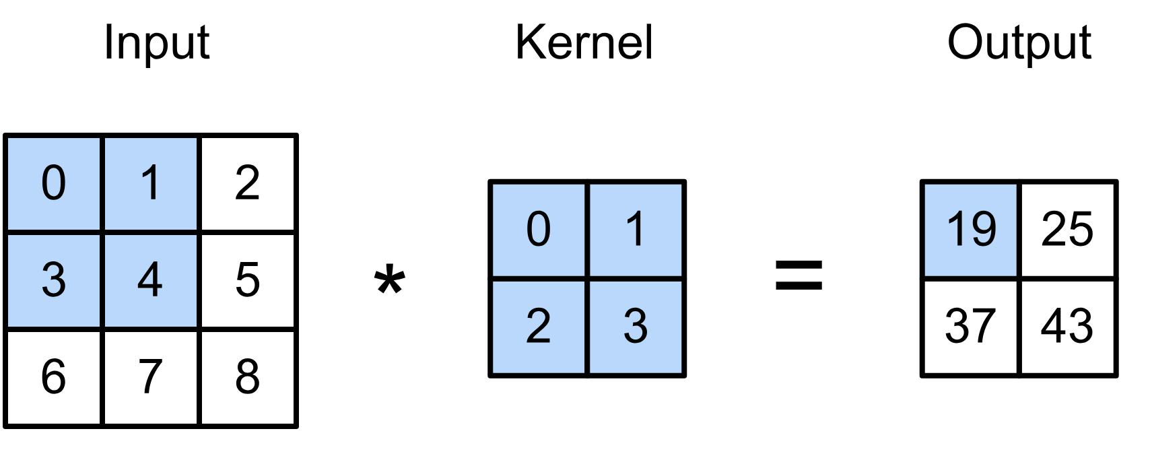
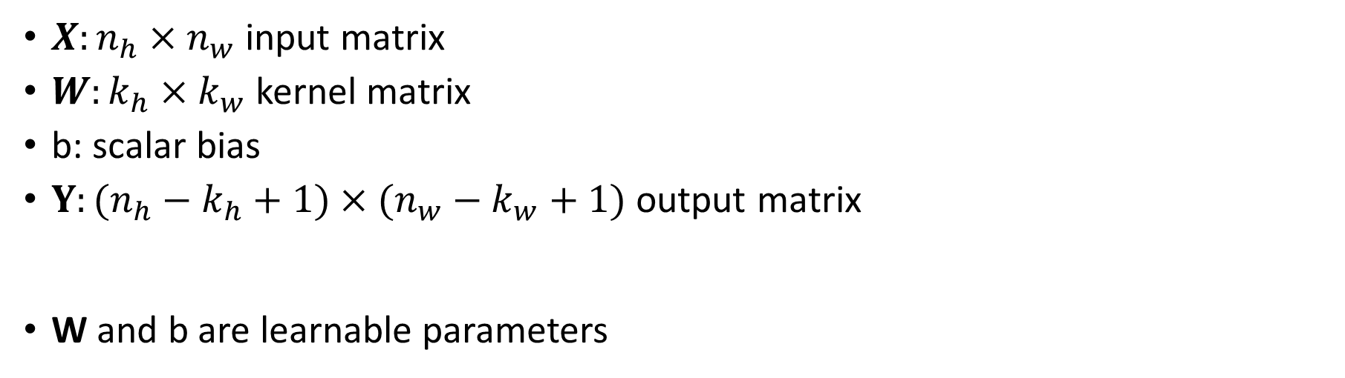
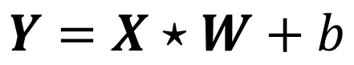
2-D Convolution Layer
$X:n_{h}×n_{w}$ input matrix
$W:k_{h}×k_{w}$ kernel matrix
b: scalar bias
$Y:(n_{h}−k_{h}+1)×(n_{w}−k_{w}+1)$ output matrix
W and b are learnable parameters
$$Y=X⋆W+b$$

Slide 16
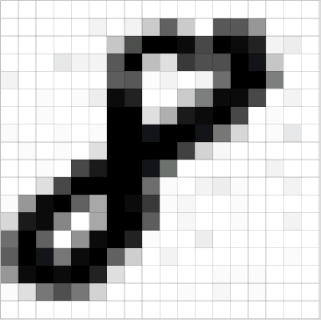
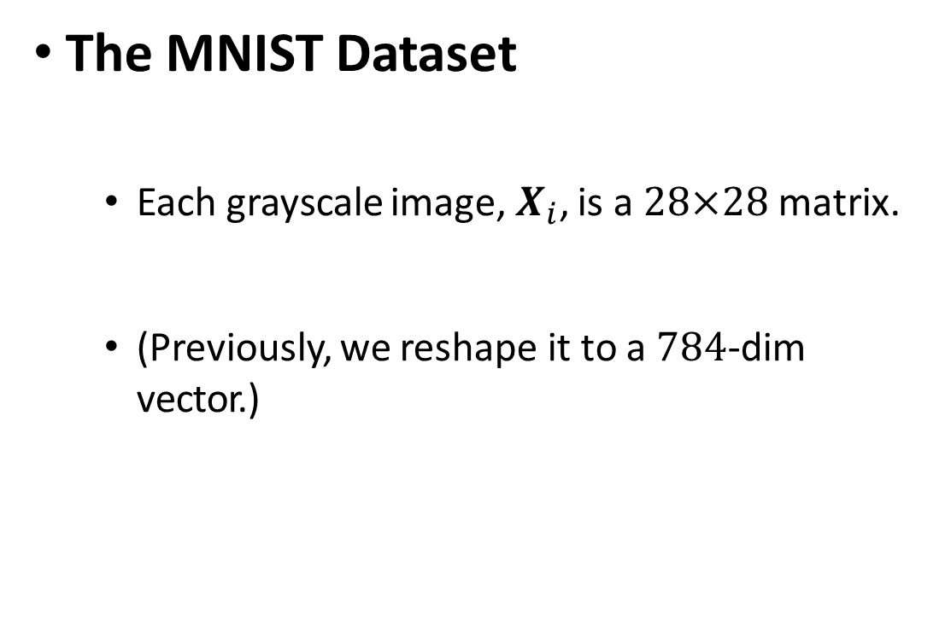
An Image is A Matrix/Tensor of Pixel Values
The MNIST Dataset
Each grayscale image, $X_{i}$, is a 28×28 matrix.
(Previously, we reshape it to a 784-dim vector.)
Notes:
一个图像是一个像素值的矩阵/张量

Slide 17
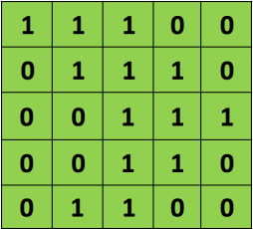
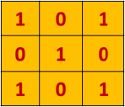
Convolution
Input Image
5×5
Filter (Kernel)
3×3
Question: how many 3×3 patches does a 5×5 image have?
Notes:
一个图像中包含多少3*3的像素块

Slide 18
Convolution
Input Image
5×5
Filter (Kernel)
3×3
3×3 patch
Question: how many 3×3 patches does a 5×5 image have?
Answer: 5 − 3 + 1 × 5 − 3 + 1 = 9.

Slide 19
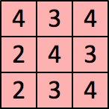
Convolution
Input Image
5×5
Filter (Kernel)
3×3
Convolution:
Result
3×3

Slide 20
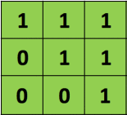
Convolution
Input Image
5×5
Filter (Kernel)
3×3
3×3 patch
Convolution:
Result
3×3
The value
4
is the inner product of the patch
and the filter
.

Slide 21
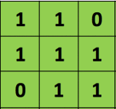
Convolution
Input Image
5×5
Filter (Kernel)
3×3
Convolution:
Result
3×3
The value
3
is the inner product of the patch
and the filter
.

Slide 22
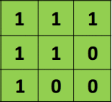
Convolution
Input Image
5×5
Filter (Kernel)
3×3
Convolution:
Result
3×3
The value
4
is the inner product of the patch
and the filter
.

Slide 23
Convolution
Input Image
5×5
Filter (Kernel)
3×3
Convolution:
Result
3×3

Slide 24

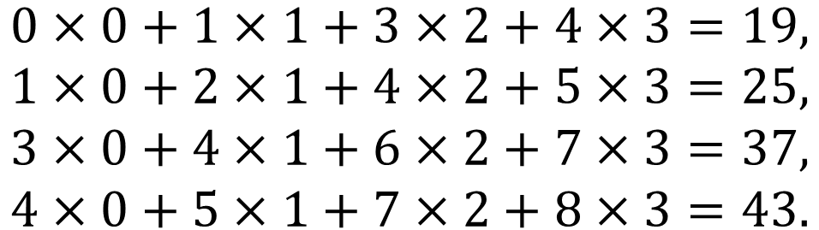
2-D Convolution Layer
$$\begin{aligned}0×0+1×1+3×2+4×3=19, \\ 1×0+2×1+4×2+5×3=25, \\ 3×0+4×1+6×2+7×3=37, \\ 4×0+5×1+7×2+8×3=43.\end{aligned}$$
(vdumoulin@ Github)

Slide 25
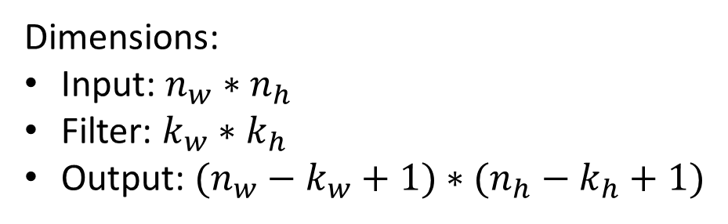
Convolution
Input Image
5×5
Filter (Kernel)
3×3
Convolution:
Result
3×3
Dimensions:
Input: $n_{w}∗n_{h}$
Filter: $k_{w}∗k_{h}$
Output: $(n_{w}−k_{w}+1)∗(n_{h}−k_{h}+1)$

Slide 26
Convolution
Input Image
4×4
Filter (Kernel)
3×3
Convolution:
Result
2×2

Slide 27
Intuition
0 | 0 | 0 | 0 | 0 | 0 | 0
0 | 1 | 0 | 0 | 0 | 1 | 0
0 | 0 | 1 | 0 | 1 | 0 | 0
0 | 0 | 0 | 1 | 0 | 0 | 0
0 | 0 | 1 | 0 | 1 | 0 | 0
0 | 1 | 0 | 0 | 0 | 1 | 0
0 | 0 | 0 | 0 | 0 | 0 | 0
1 | 0 | 0
0 | 1 | 0
0 | 0 | 1
Filter (Kernel)
3×3
Input Image
7×7
Result
?×?

Slide 28
Intuition
0 | 0 | 0 | 0 | 0 | 0 | 0
0 | 1 | 0 | 0 | 0 | 1 | 0
0 | 0 | 1 | 0 | 1 | 0 | 0
0 | 0 | 0 | 1 | 0 | 0 | 0
0 | 0 | 1 | 0 | 1 | 0 | 0
0 | 1 | 0 | 0 | 0 | 1 | 0
0 | 0 | 0 | 0 | 0 | 0 | 0
1 | 0 | 0
0 | 1 | 0
0 | 0 | 1
2 | 0 | 1 | 0 | 1
0 | 3 | 0 | 1 | 0
1 | 0 | 3 | 0 | 1
0 | 1 | 0 | 3 | 0
1 | 0 | 1 | 0 | 2
Filter (Kernel)
3×3
Input Image
7×7
Result
5×5

Slide 29
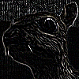
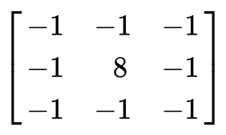
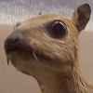
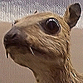
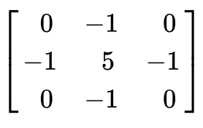

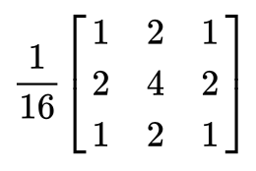
Examples
Edge Detection
Sharpen
Gaussian Blur
Notes:
边缘发现、图像锐化、高斯滤波

Slide 30
Examples
Edge Detection
−1 −1 −1 0.1 0.1 0.1
8 −1 and 0.1 0.1
−1 −1 −1 0.1 0.1 0.1
−1 −1 −1 0.1 0.1 0.1
8 −1 and 0.1 0.2
−1 −1 −1 0.1 0.1 0.1
The inner product of −1
0.1 is 0.
The inner product of −1
0.1 is 0.8.

Slide 31
Examples
Edge Detection
Sharpen
0 −1 0
The inner product of −1 5 −1
0 −1 0
0 −1 0
5 −1
0 −1 0
0.1 0.1 0.1
0.1 0.1 0.1 is 0.1.
0.1 0.1 0.1
0.1 0.1 0.1
0.1 0.2 0.1 is 0.6.
0.1 0.1 0.1
•
and
•
The inner product of −1
and

Slide 32
Examples
Edge Detection
Sharpen
Gaussian Blur

Slide 33
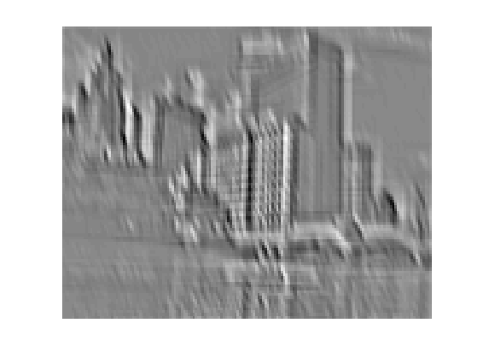
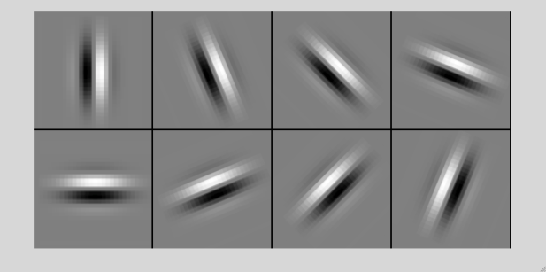
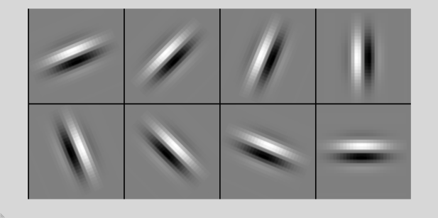
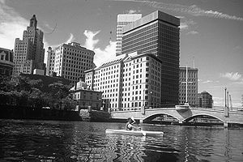
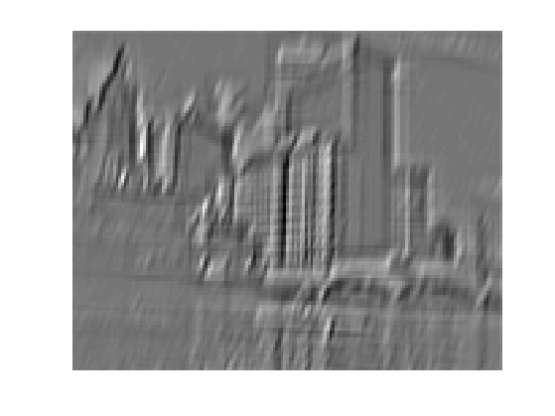
Examples
(Rob Fergus)

Slide 34
Padding and Stride
Notes:
填充和步长

Slide 35
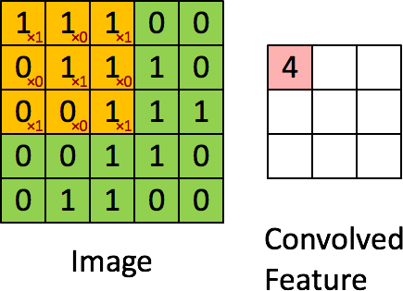
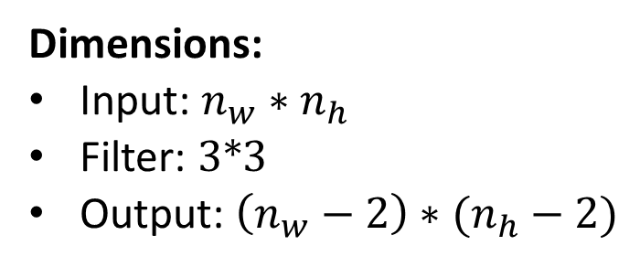
Convolution: Zero Padding
Input Image
5×5
Filter (Kernel)
3×3
Dimensions:
Input: $n_{w}∗n_{h}$
Filter: $3∗3$
Output: $\left(n_{w}−2\right)∗(n_{h}−2)$
Convolution:
Notes:
零填充

Slide 36
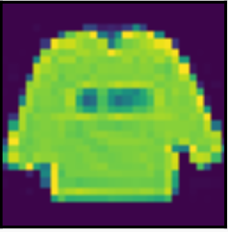

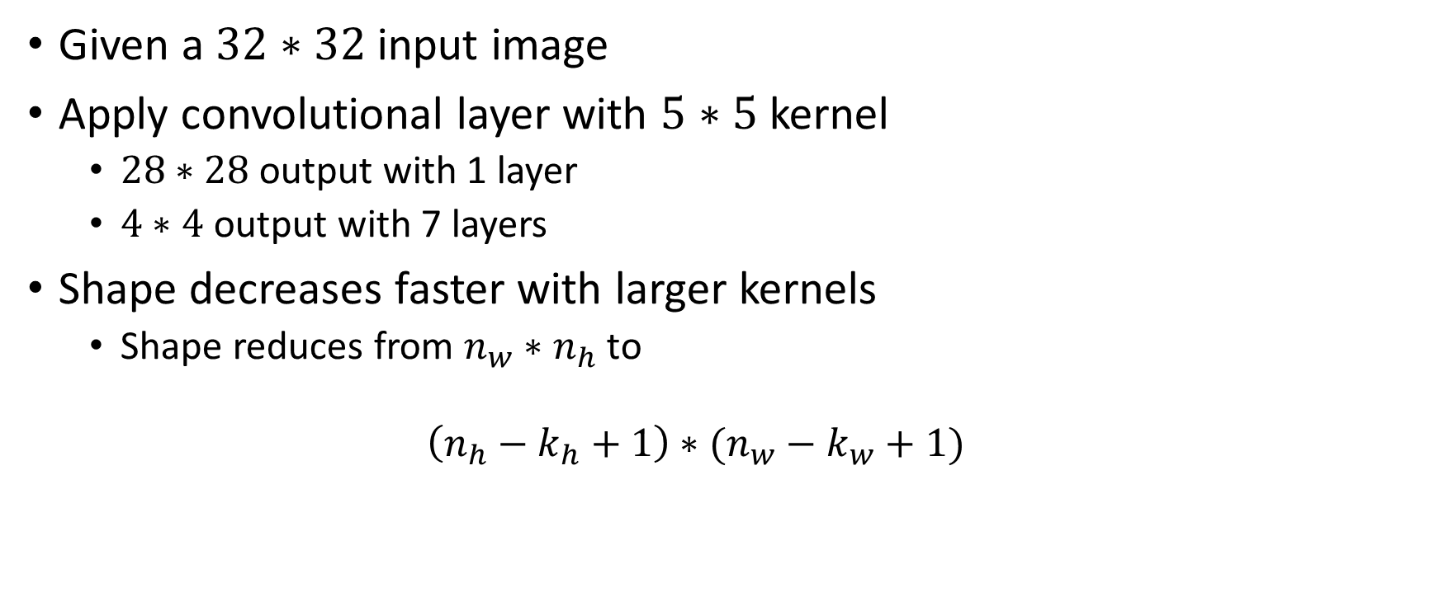
Padding
Given a $32∗32$ input image
Apply convolutional layer with $5∗5$ kernel
$28∗28$ output with 1 layer
$4∗4$ output with 7 layers
Shape decreases faster with larger kernels
Shape reduces from $n_{w}∗n_{h}$ to
$$\left(n_{h}−k_{h}+1\right)∗(n_{w}−k_{w}+1)$$
Notes:
卷积核越大图像形状减小速度越快

Slide 37

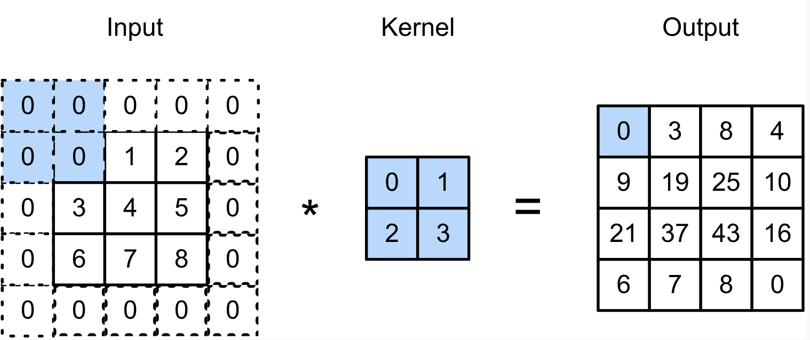
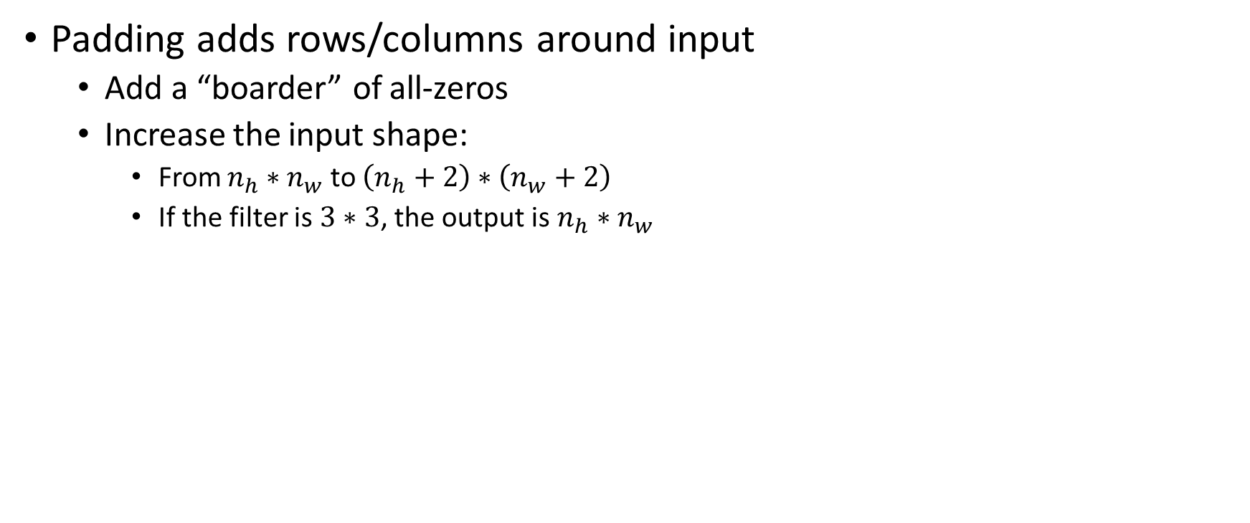
Padding
Padding adds rows/columns around input
Add a “boarder” of all-zeros
Increase the input shape:
From $n_{h}∗n_{w}$ to $\left(n_{h}+2\right)∗\left(n_{w}+2\right)$
If the filter is $3∗3$, the output is $n_{h}∗n_{w}$
Notes:
在矩阵的边界上田中全是0的伪像素。

Slide 38
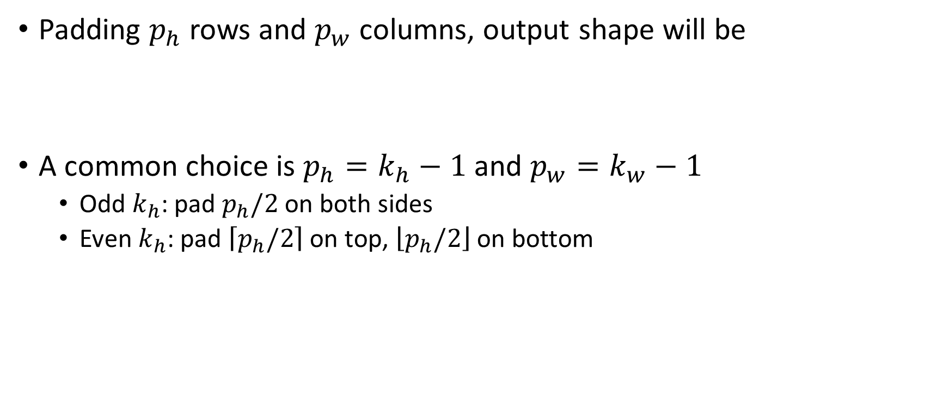
Padding
Padding $p_{h}$ rows and $p_{w}$ columns, output shape will be
A common choice is $p_{h}=k_{h}−1$ and $p_{w}=k_{w}−1$
Odd $k_{h}$: pad $p_{h}/2$ on both sides
Even $k_{h}$: pad $\left\lceil p_{h}/2\right\rceil$ on top, $\left\lfloor p_{h}/2\right\rfloor$ on bottom
$$(n_{h}−k_{h}+p_{h}+1)×(n_{w}−k_{w}+p_{w}+1)$$

Slide 39
Stride
Padding reduces shape linearly with #layers
Given a 224 x 224 input with a 5 x 5 kernel, needs 44 layers to reduce the shape to 4 x 4
Requires a large amount of computation
Notes:
填充方法减小图像的形状与层数线性相关

Slide 40
Stride
In the previous examples, the stride is 1
The filter moves 1 step each time
Notes:
过滤器（卷积核）每次移动一步

Slide 41

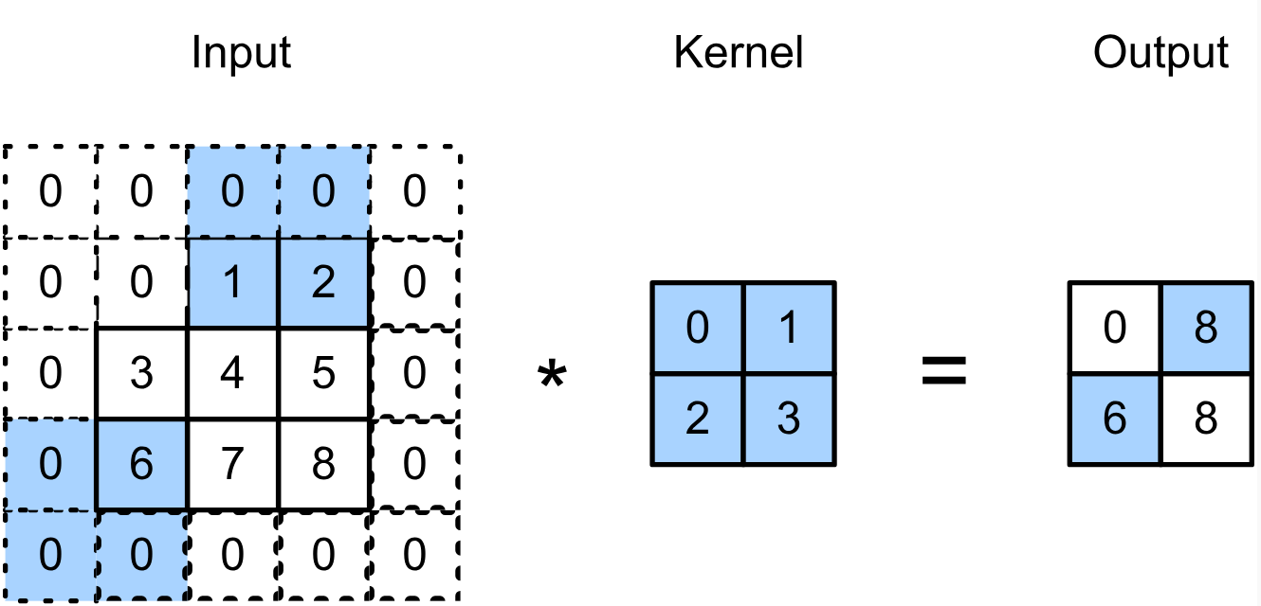
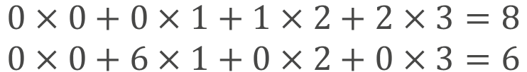
Stride
Stride is the #rows/#columns per slide
Strides of 3 and 2 for height and width
$$\begin{aligned}0×0+0×1+1×2+2×3=8 \\ 0×0+6×1+0×2+0×3=6\end{aligned}$$
Notes:
步长为每次滑动的行数和列数

Slide 42
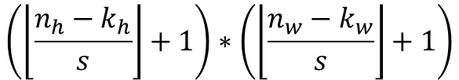
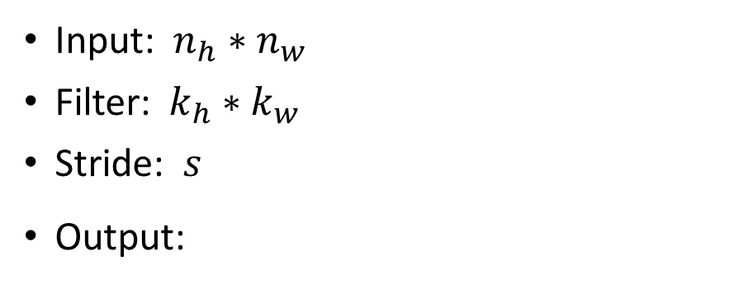
Stride
Stride is the #rows/#columns per slide
The stride can be 2 or even larger.
Dimensions:
Input: $n_{h}∗n_{w}$
Filter: $k_{h}∗k_{w}$
Stride: $s$
Output:
$$\left(\left\lfloor \frac{n_{h}−k_{h}}{s}\right\rfloor +1\right)∗\left(\left\lfloor \frac{n_{w}−k_{w}}{s}\right\rfloor +1\right)$$
Notes:
步长可以设置为2或者更大

Slide 43
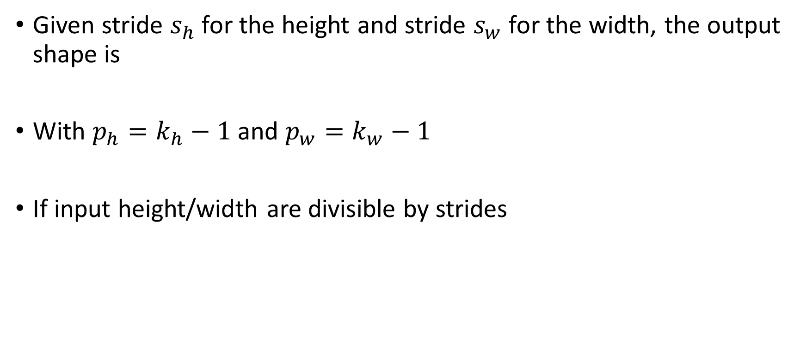
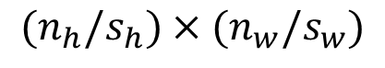
Stride
Given stride $s_{h}$ for the height and stride $s_{w}$ for the width, the output shape is
With $p_{h}=k_{h}−1$ and $p_{w}=k_{w}−1$
If input height/width are divisible by strides
$$⌊(n_{h}−k_{h}+p_{h}+s_{h})/s_{h}⌋×⌊(n_{w}−k_{w}+p_{w}+s_{w})/s_{w}⌋$$
$$⌊(n_{h}+s_{h}−1)/s_{h}⌋×⌊(n_{w}+s_{w}−1)/s_{w}⌋$$
$$(n_{h}/s_{h})×(n_{w}/s_{w})$$
Notes:
给定步长的高度为sh、宽度为sw，则输出的大小为….
当填充的高度ph=kh-1，宽度pw=kw-1时，输出的大小为…
如果输入的宽度/高度能够被步长的宽度/高度整除，则输出的大小为…

Slide 44
Multiple Input and Output Channels
Notes:
多输入和输出通道

Slide 45
Multiple Input Channels
Color image may have three RGB channels
Converting to grayscale loses information
Notes:
多输入通道
彩色图像一般有RGB三个通道
转换为灰度图像会丢失信息

Slide 46
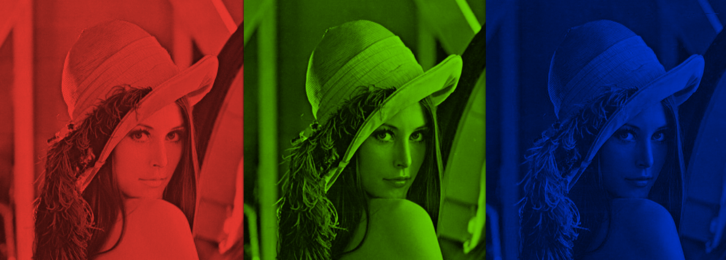
Multiple Input Channels
Color image may have three RGB channels
Converting to grayscale loses information

Slide 47
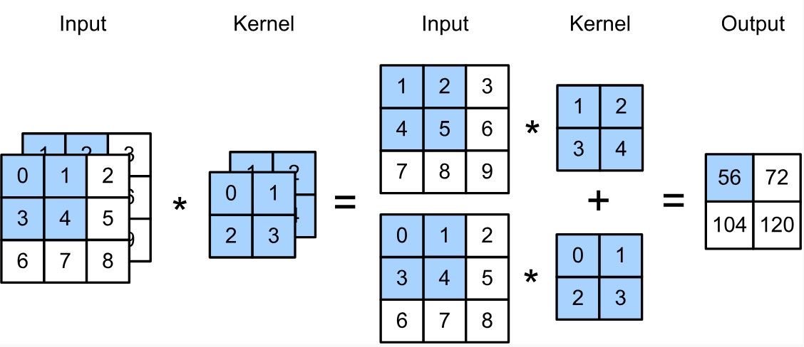
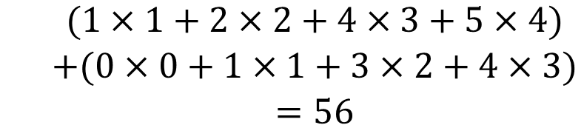
Multiple Input Channels
Have a kernel for each channel, and then sum results over channels
$$\begin{matrix} & (1×1+2×2+4×3+5×4) \\ & +(0×0+1×1+3×2+4×3) \\ & =56\end{matrix}$$
Notes:
每一个通道都有一个卷积核，然后对各个通道的结果求和

Slide 48
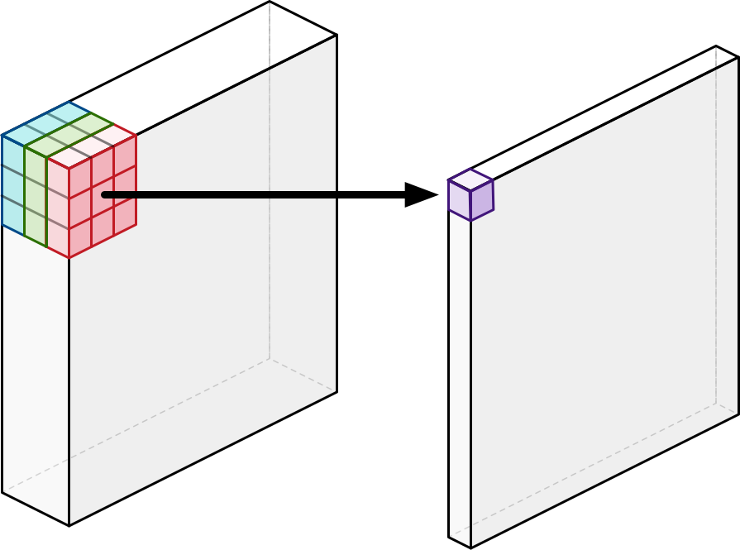
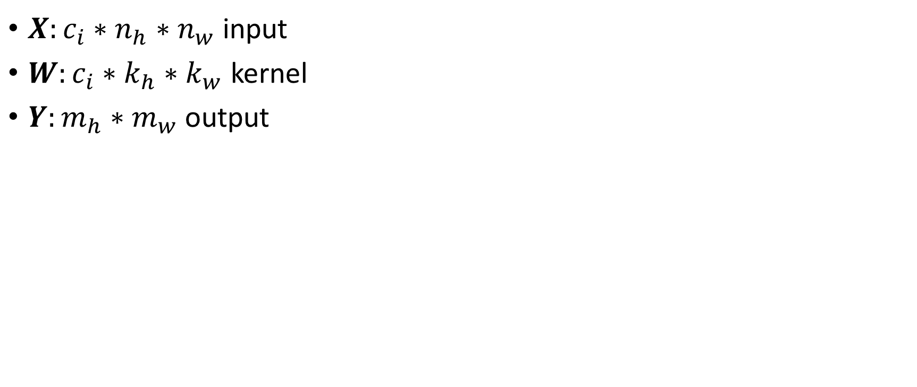


Multiple Input Channels
$X:c_{i}∗n_{h}∗n_{w}$ input
$W:c_{i}∗k_{h}∗k_{w}$ kernel
$Y:m_{h}∗m_{w}$ output
$$Y=\overset{c_{i}}{\underset{i=0}{∑}}X_{i,:,:}⋆W_{i,:,:}$$
The input is an order-3 tensor of shape $3∗n_{h}∗n_{w}$
The filter is an order-3 tensor of shape $3∗3∗3$
The output is a matrix (order-2 tensor) of shape $\left(n_{h}−2\right)∗(n_{w}−2)$
Notes:
ci表示第i个通道
输入为3维张量3*nh*nw
卷积核为三维张量3*3*3
输出为二维张量

Slide 49



Multiple Output Channels
No matter how many inputs channels, so far we always get single output channel
We can have multiple 3-D kernels, each one generates an output channel
Input $X:c_{i}∗n_{h}∗n_{w}$
Kernel $W:c_{o}∗c_{i}∗k_{h}∗k_{w}$
Output $Y:c_{o}∗m_{h}∗m_{w}$
$$Y_{i,:,:}=X⋆W_{i,:,:,:}$$
$$\text{for}i=1,…,c_{o}$$
Notes:
多输出通道
不管有多少输入通道，到目前为止，我们总是得到一个输出通道
我们可以有多个三维卷积核，每个都产生一个输出通道

Slide 50







Multiple Input/Output Channels
Each output channel may recognize a particular pattern
Input channels kernels recognize and combines patterns in inputs
Notes:
每个输出通道可以识别一个特定的模式
输入通道的卷积核识别并组合输入中的模式

Slide 51
Key Concepts
Input, filter (kernel), and output (feature map)
Convolution for matrix (order-2 tensor)
Convolution for order-3 tensor
Zero padding
Stride
https://cs231n.github.io/convolutional-networks/
Notes:
关键概念
输入，过滤器（卷积核），输出（特征映射）
对二维张量的卷积
对三维张量的卷积
0填充
步长

Slide 52
Pooling Layer
Notes:
池化层

Slide 53
Pooling
Convolution is sensitive to position
We need some degree of invariance to translation
Lighting, object positions, scales, appearance vary among images
Notes:
卷积对位置很敏感
我们需要某种程度的平移不变性
光线、对象位置、大小、外观因图像而异

Slide 54

Pooling
Max Pooling
Settings:
Max Pooling.
Pool size = 2×2.
No overlap (stride = 2×2).
Notes:
最大池化

Slide 55
Pooling
Average Pooling
Settings:
Average Pooling.
Pool size = 2×2.
No overlap (stride = 2×2).
Notes:
平均池化

Slide 56
Pooling
Average Pooling
Settings:
Average Pooling.
Pool size = 2×2.
No overlap (stride = 2×2).
Question: What is the output shape?
Input shape: 12×12.
Pool size: 3×3.
No overlap (stride: 3×3).

Slide 57


Pooling
Max pooling: the strongest pattern signal in a window
Average pooling: replace max with mean in a max pooling
The average signal strength in a window
Max pooling
Average pooling
Notes:
最大池化：窗口中最强的模式信号
平均池化：窗口中的平均信号强度

Slide 58

Padding, Stride, and Multiple Channels
Pooling layers have similar padding and stride as convolutional layers
No learnable parameters
Apply pooling for each input channel to obtain the corresponding output channel
#output channels = #input channels
Notes:
池化层具有与卷积层相似的填充和步幅
没有可学习的参数
对每个输入通道进行池化得到相应的输出通道

Slide 59
Convolutional Neural Networks (CNNs)
Notes:
卷积神经网络

Slide 60

Convolutional Layer 1
Use multiple filters (kernels) for the feature mapping. E.g.,
using ten 5×5 filters, (merely 10×5×5 = 250 parameters!)
the results are ten 24×24 matrices.
Notes:
对特征映射使用多个过滤器(卷积核)
如10个5*5的卷积核（有250个参数）
得到10个24*24的输出矩阵

Slide 61
Convolutional Layer 1
Use multiple filters (kernels) for the feature mapping. E.g.,
Apply an activation function (e.g., ReLU).
A Convolutional layer = convolution + activation
Notes:
ReLU激活
卷积层=卷积+激活

Slide 62
CNN: Pooling Layer 1
Pooling reduces the dimensionality of each feature map.
E.g., Max Pooling, Average Pooling, etc.
Notes:
池化降低了每个特征映射的维数。

Slide 63
CNN: Convolutional Layer 2
Perform tensor convolution.
Apply 5×5×10 tensor filter to the 12×12×10 tensor input
Twenty such filters ➔ twenty 8×8 feature maps.
12*12*10 tensor
(order-3 tensor)
Notes:
对张量进行卷积
用5*5*10的卷积核对12*12*10的输入张量进行卷积
20个卷积核得到20个8*8的特征映射

Slide 64
CNN: Convolutional Layers
Convolution for matrix (order-2 tensor)
Convolution for order-3 tensor
Order-3 tensor
Matrix (order 2 tensor)

Slide 65
CNN: Pooling Layer 2
2×2 Max Pooling applied to an 8×8 matrix ➔ a 4×4 matrix.
Notes:
对8*8的输入用2*2的最大池化，得到4*4的输出

Slide 66
CNN: Flatten(Vectorization)
Flatten the 4×4×20 tensor.
Get a 320-dim vector
Notes:
将4*4*20的张量展平得到320维的向量

Slide 67
CNN: Fully-Connected Layers
Add one or more fully-connected layers
This one is optional.
Notes:
全连接层
使用1到多个全连接层

Slide 68
CNN: How Many Trainable Parameters?
10×5×5 = 250 parameters
10: number of filters
5×5: size of filters
20×5×5×10 = 5000 parameters
20: number of filters
5×5×10: size of filters
320×100 = 32,000 parameters
100×10 = 1,000 parameters
Notes:
参数量：
第一个卷积层：10*5*5=250
第二个卷积层：20*（5*5*10）=5000
第一个全连接层：320*100=3.2w
第二个全连接层：100*10=1000

Slide 69
CNN: How Many Trainable Parameters?
Answer: > 38,250 parameters (not counting the intercepts).
10×5×5 = 250 parameters
10: number of filters
5×5: size of filters
20×5×5×10 = 5000 parameters
20: number of filters
5×5×10: size of filters
320×100 = 32,000 parameters
100×10 = 1,000 parameters
Notes:
总共超过38250个参数（不包括偏置参数）

Slide 70
CNN Explainer (poloclub.github.io)

Slide 71

CNN: Re-Cap
Question: Why convolutional layers?
Answer: detect features like edge, shape, pattern, etc.
Notes:
使用cnn的原因：检测特征，如边缘，形状，模式等

Slide 72
CNN: Re-Cap
Question: Why convolutional layers?
Answer: detect features like edge, shape, pattern, etc.
Question: Why activation functions like ReLU?
Answer: Add nonlinearity to increase the expressive power. (Note that convolution is a linear function.)
Notes:
为什么使用激活函数：增加非线性函数以增加表达能力。(注意，卷积是一个线性函数。)

Slide 73
CNN: Re-Cap
Question: Why convolutional layers?
Answer: detect features like edge, shape, pattern, etc.
Question: Why activation functions like ReLU?
Answer: Add nonlinearity to increase the expressive power. (Note that convolution is a linear function.)
Question: Why pooling?
Answer: Drastically reduce the shape of features.
Notes:
为什么池化：大幅度降低特征的数量

Slide 74
Hyper-parameters of CNN
Notes:
CNN的超参数

Slide 75
Hyper-Parameters for Network Structure
Convolutional layers
# Filters
Filter shape
Stride
Zero-padding
Pooling layers
MaxPool or AvgPool
Pool size
Pool stride
Fully-connected layers
Width
Activation functions
ReLU
SoftMax
Sigmoid
Notes:
卷积层：过滤器数量，过滤器大小，步长，0填充
池化层：最大/平均池化，池化窗口大小，步长
全连接层：全连接宽度
激活函数：

Slide 76
Hyper-Parameters for Network Structure
Loss function.
Cross-entropy for classification
L1 or L2 for regression (the labels are continuous)
Optimization algorithm (and its hyper-parameters, e.g., learning rate).
SGD
SGD with momentum
AdaGrad
RMSprop
Random initialization.
Gaussian or uniform?
Scaling
Notes:
损失函数：交叉熵/用于回归问题的L1/L2
优化器：SGD/引入动量的SGD/…
随机初始化方式

Slide 77
LeNet Architecture
Notes:
LeNet结构

Slide 78


Handwritten Digit Recognition
Notes:
手写数字识别

Slide 79
MNIST
Centered and scaled
50,000 training data
10,000 test data
28 x 28 images
10 classes
Notes:
MNIST数据集
居中，缩放到相同大小
50000训练数据
10000测试数据
28*28的图片
10类

Slide 80

MNIST
Centered and scaled
50,000 training data
10,000 test data
28 x 28 images
10 classes

Slide 81
Summary

Slide 82
1. Convolution
Matrix convolution and tensor convolution.
Concepts:
filter (kernel)
patch
output (feature map)
zero-padding
Stride
Convolution arithmetic https://github.com/vdumoulin/conv_arithmetic

Slide 83
2. Convolutional Neural Network
Convolutional layers.
Filter number.
Filter shape.
Stride (default: one).
Zero-padding (default: no padding).

Slide 84
2. Convolutional Neural Network
Convolutional layers.
Filter number.
Filter shape.
Stride (default: one).
Zero-padding (default: no padding).
Activation functions.
Pooling layers.
MaxPool, AveragePool, etc.
Pool size.
Pool stride (default: pool size).

Slide 85
3. Build and Train CNN
Build a network.
Add Conv, Pool, FC layers.
Compile the model.
Specify optimization algorithm, loss function, and metrics.
Fit the model on training data.

